Slide 1
ECE 411 Spring 2016 Lecture 8
Pipelining

Slide 2
Review -- Instruction Latencies
Cycle 1
Cycle 2
Cycle 3
Cycle 4
Cycle 5
Ifetch
Reg/Dec
Exec
Mem
Wr
Ifetch
Reg/Dec
Exec
Wr
Load
Add

Slide 3
Instruction Latencies and Throughput
Multiple Cycle CPU
Cycle 1
Cycle 2
Cycle 3
Cycle 4
Cycle 5
Ifetch
Reg/Dec
Exec
Mem
Wr
Ifetch
Reg/Dec
Exec
Wr
Pipelined CPU
Cycle 1
Cycle 2
Cycle 3
Cycle 4
Cycle 5
Cycle 6
Cycle 7
Cycle 8
Load
Ifetch
Reg/Dec
Exec
Mem
Wr
Add
Ifetch
Reg/Dec
Exec
-
Wr
…
Ifetch
Reg/Dec
Exec
Mem
Wr
…
Ifetch
Reg/Dec
Exec
Mem
Wr
Latency – longer (worse)
Throughput – higher (better)

Slide 4
Pipelining - Analogy
https://www.youtube.com/watch?v=ecCt6HPlPeA

Slide 5
Pipelined Execution Timing
CC1
CC2
CC3
CC4
CC5
CC6
CC7
CC8
CC9
IF
ID
EX
MEM
WB
IM
Reg
ALU
DM
Reg
IF
ID
EX
MEM
WB
IM
Reg
ALU
DM
Reg
IM
Reg
ALU
DM
Reg
IM
Reg
ALU
DM
Reg
IM
Reg
ALU
DM
Reg
steady
state

Slide 6
Execution in a Pipelined Datapath
Instruction Fetch
Instruction Decode/
Register Fetch
sub $15, $4, $1
lw $12, 1000($4)
add $10, $1, $2

Slide 7
Speed up calculation
Assuming the stages are perfectly balanced
Time between instructions (pipelined) =
Time between instructions (nonpipelined) / # of stages

Slide 8
Pipelining Example 1
A processor that takes 5ns to execute an instruction is pipelined into 5 equal stages. The latch between each stage has a delay of 0.25 ns.
What is the minimum clock cycle time of the pipelined processor?
5/5+0.25 = 1.25 ns
What is the maximum speedup that can be achieved by this pipelined processor? (compared to the original processor)
4× (1 instr every 1.25ns vs 1 instr every 5 ns)
Can we have much deeper pipelining?
If we divide into 10 stages, the clock will be 0.75 ns and the speedup will at most 6.7×, diminishing return!

Slide 9
Pipelining Example 2
A non-pipelined processor takes 5ns to execute an instruction. If I want clock the processor at 2GHz, how many stages should I pipeline this processor into if each latch has a 0.25ns delay?
What is the maximum speedup that can be achieved by the pipelined processor running at 2GHz? (compared to the original single cycle processor)
What is the average latency of an instruction?
How many stages if I want to clock the processor at 5GHz?

Slide 10
Hazards
Situations that prevent starting the next instruction in the next cycle
Structure hazards
A required resource is busy
Data hazard
Need to wait for previous instruction to complete its data read/write
Control hazard
Deciding on control action depends on previous instruction

Slide 11
Data Hazards
When a result is needed in the pipeline before it is available, a data hazard occurs
CC1
CC2
CC3
CC4
CC5
CC6
CC7
CC8
sub $2, $1, $3
IM
Reg
ALU
DM
Reg
R2 Available
IM
Reg
ALU
DM
Reg
and $12, $2, $5
IM
Reg
ALU
DM
Reg
or $13, $6, $2
R2 Needed
IM
Reg
ALU
DM
Reg
add $14, $2, $2
Hazards! Value in register
hasn’t been updated
No hazard here
IM
Reg
ALU
DM
sw $15, 100($2)
Time: 1 2 3 4 5 6 7 8
Clock cycles

Slide 12
Data Hazard – Data Path View
add $10, $1, $2
add $11, $8, $7
lw $8, 52($3)
add $3, $10, $11
Write Back
And this should be value
from memory (which hasn’t
even been loaded yet).
This should
have been “92”
16
14
16
50
66
42

Slide 13
Branch Hazards
CC1
CC2
CC3
CC4
CC5
CC6
CC7
CC8
beq $2, $1, here
IM
Reg
ALU
DM
Reg
add ...
IM
Reg
ALU
DM
Reg
IM
Reg
ALU
DM
Reg
sub ...
These instructions
shouldn’t be executed!
IM
Reg
ALU
DM
Reg
lw ...
IM
Reg
ALU
DM
here: lw ...
Finally, the right instruction

Slide 14
Dealing with Data Hazards in Software
Insert nop
CC1
CC2
CC3
CC4
CC5
CC6
CC7
CC8
sub $2, $1, $3
IM
Reg
ALU
DM
Reg
nop
IM
Reg
ALU
DM
Reg
IM
Reg
ALU
DM
Reg
nop
IM
Reg
ALU
DM
Reg
add $12, $2, $5
Insert enough no-ops (or other instructions that don’t
use register 2) so that data hazard doesn’t occur,

Slide 15
Handling Data Hazards in Hardware
Stall the fetch and insert bubbles
CC1
CC2
CC3
CC4
CC5
CC6
CC7
CC8
sub $2, $1, $3
IM
Reg
DM
Reg
and $12, $2, $5
IM
Bubble
Bubble
Reg
DM
Reg
or $13, $6, $2
IM
Reg
DM
Reg
IM
Reg
DM
add $14, $2, $2

Slide 16
Pipeline Stalls
To insure proper pipeline execution in light of register dependences, we must:
Detect the hazard
Stall the pipeline
Prevent the IF and ID stages from making progress
Insert “no-ops” into later stages

Slide 17
Register Scoreboard
Track operand availability
Add valid bit to each register in the reg file
HW clears valid bit when an instr writing the reg issues (leaves decode/reg read stage)
HW sets valid bit when an instr writing the reg completes
Instrs are not allowed to issue if any of their source regs are invalid

Slide 18
Stalling the Pipeline
Prevent the IF and ID stages from proceeding
Don’t write the PC (PCWrite = 0)
Don’t rewrite IF/ID register (IF/IDWrite = 0)
Insert nop
Set all control signals propagating to EX/MEM/WB to zero

Slide 19
Reducing Data Hazards: Forwarding
add $2, $3, $4
IM
Reg
ALU
DM
Reg
or $5, $3, $2
IM
Reg
ALU
DM
Reg
We could avoid stalling if we could get the ALU output from “add” to ALU input
for the “or”
ID/EX
EX/MEM
MEM/WB
Registers
ALU
Data
Memory
0
1

Slide 20
Reducing Data Hazards: Forwarding
CC1
CC2
CC3
CC4
CC5
CC6
CC7
CC8
sub $2, $1, $3
IM
Reg
ALU
DM
Reg
IM
Reg
ALU
DM
Reg
and $6, $2, $5
IM
Reg
ALU
DM
Reg
or $13, $6, $2
IM
Reg
ALU
DM
Reg
add $14, $2, $2
IM
Reg
ALU
DM
sw $15, 100($2)

Slide 21
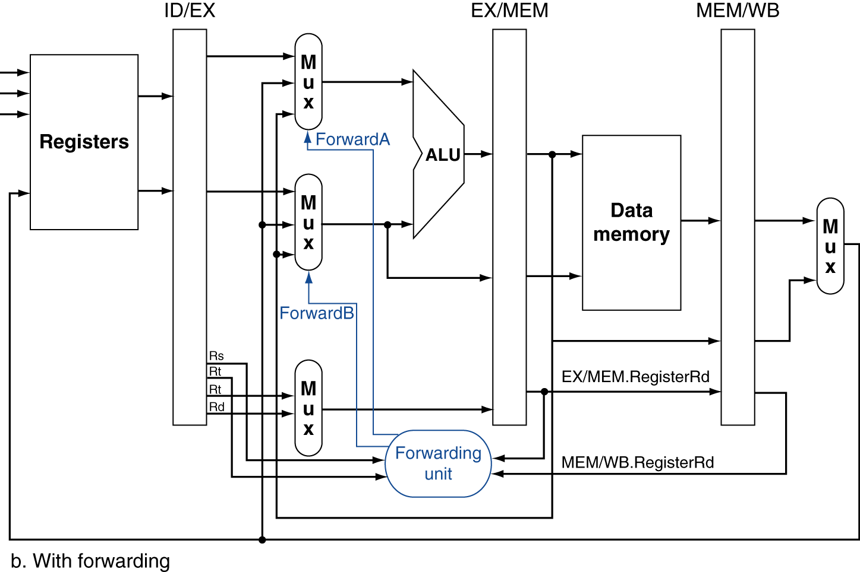
Forwarding Paths

Slide 22
Forwarding Conditions
EX hazard
if (EX/MEM.RegWrite & (EX/MEM.RegisterRd ≠ 0) & (EX/MEM.RegisterRd = ID/EX.RegisterRs)) ForwardA = 10
if (EX/MEM.RegWrite & (EX/MEM.RegisterRd ≠ 0) & (EX/MEM.RegisterRd = ID/EX.RegisterRt)) ForwardB = 10
MEM hazard
if (MEM/WB.RegWrite & (MEM/WB.RegisterRd ≠ 0) & (MEM/WB.RegisterRd = ID/EX.RegisterRs)) ForwardA = 01
if (MEM/WB.RegWrite & (MEM/WB.RegisterRd ≠ 0) & (MEM/WB.RegisterRd = ID/EX.RegisterRt)) ForwardB = 01

Slide 23
Double Data Hazard
Consider the sequence:
add $1,$1,$2
add $1,$1,$3
add $1,$1,$4
Both hazards occur
Want to use the most recent
Revise MEM hazard condition
Only fwd if EX hazard condition isn’t true

Slide 24
Revised Forwarding Condition
MEM hazard
if (MEM/WB.RegWrite & (MEM/WB.RegisterRd ≠ 0) & !(EX/MEM.RegWrite & (EX/MEM.RegisterRd ≠ 0) & (EX/MEM.RegisterRd = ID/EX.RegisterRs)) & (MEM/WB.RegisterRd = ID/EX.RegisterRs)) ForwardA = 01
if (MEM/WB.RegWrite & (MEM/WB.RegisterRd ≠ 0) & !(EX/MEM.RegWrite & (EX/MEM.RegisterRd ≠ 0) & (EX/MEM.RegisterRd = ID/EX.RegisterRt)) & (MEM/WB.RegisterRd = ID/EX.RegisterRt)) ForwardB = 01

Slide 25
Forwarding Eliminate All Data Hazards?
CC1
CC2
CC3
CC4
CC5
CC6
CC7
CC8
lw $2, 10($1)
and $12, $2, $5
or $13, $6, $2
add $14, $2, $2
sw $15, 100($2)

Slide 26
Forwarding Eliminate All Data Hazards?
CC1
CC2
CC3
CC4
CC5
CC6
CC7
CC8
lw $2, 10($1)
IM
Reg
ALU
IM
Reg
and $12, $2, $5
IM
or $13, $6, $2
add $14, $2, $2
sw $15, 100($2)

Slide 27
Forwarding Eliminate All Data Hazards?
CC1
CC2
CC3
CC4
CC5
CC6
CC7
CC8
lw $2, 10($1)
IM
Reg
ALU
DM
IM
Reg
Bubble
and $12, $2, $5
IM
or $13, $6, $2
Bubble
add $14, $2, $2
sw $15, 100($2)

Slide 28
Forwarding Eliminate All Data Hazards?
CC1
CC2
CC3
CC4
CC5
CC6
CC7
CC8
lw $2, 10($1)
IM
Reg
ALU
DM
Reg
IM
Reg
Bubble
ALU
DM
Reg
and $12, $2, $5
IM
Reg
ALU
DM
Reg
or $13, $6, $2
Bubble
IM
Reg
ALU
DM
add $14, $2, $2
IM
Reg
ALU
sw $15, 100($2)

Slide 29
Try this one...
Show stalls and forwarding for this code
add $3, $2, $1
lw $4, 100($3)
and $6, $4, $3
sub $7, $6, $2

Slide 30
Code Scheduling to Avoid Stalls
Reorder code to avoid use of load result in the next instruction
C code for A = B + E; C = B + F;
lw $t1, 0($t0)
lw $t2, 4($t0)
add $t3, $t1, $t2
sw $t3, 12($t0)
lw $t4, 8($t0)
add $t5, $t1, $t4
sw $t5, 16($t0)
lw $t1, 0($t0)
lw $t2, 4($t0)
lw $t4, 8($t0)
add $t3, $t1, $t2
sw $t3, 12($t0)
add $t5, $t1, $t4
sw $t5, 16($t0)
stall
stall
13 cycles
11 cycles

